Slide 1


Eng. Mina Magdy
‎ Install
TP-Link ‎TL-WN722N Driver
Linux & Windows

Slide 2


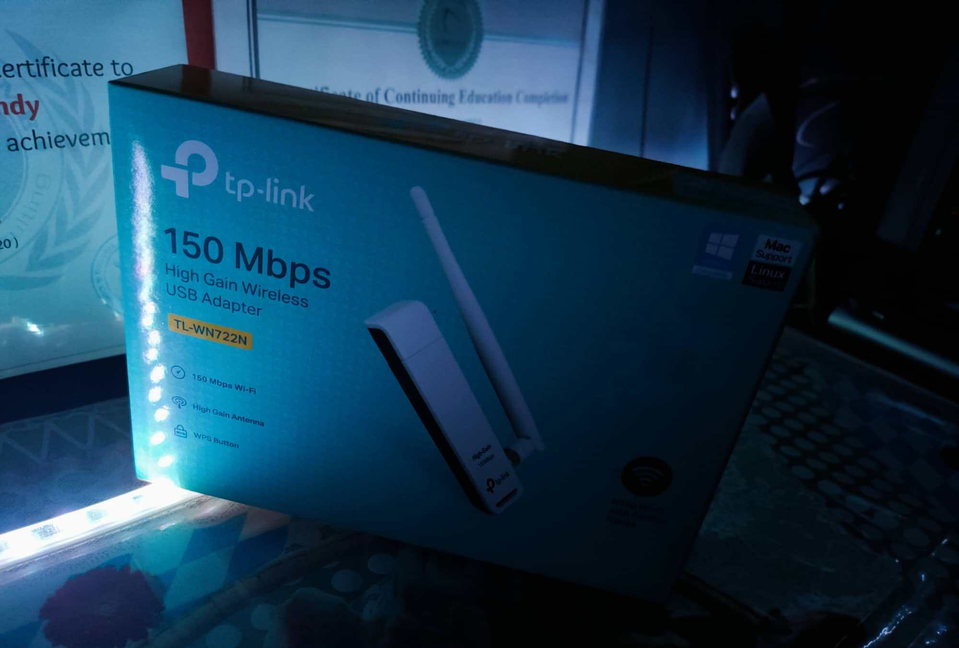
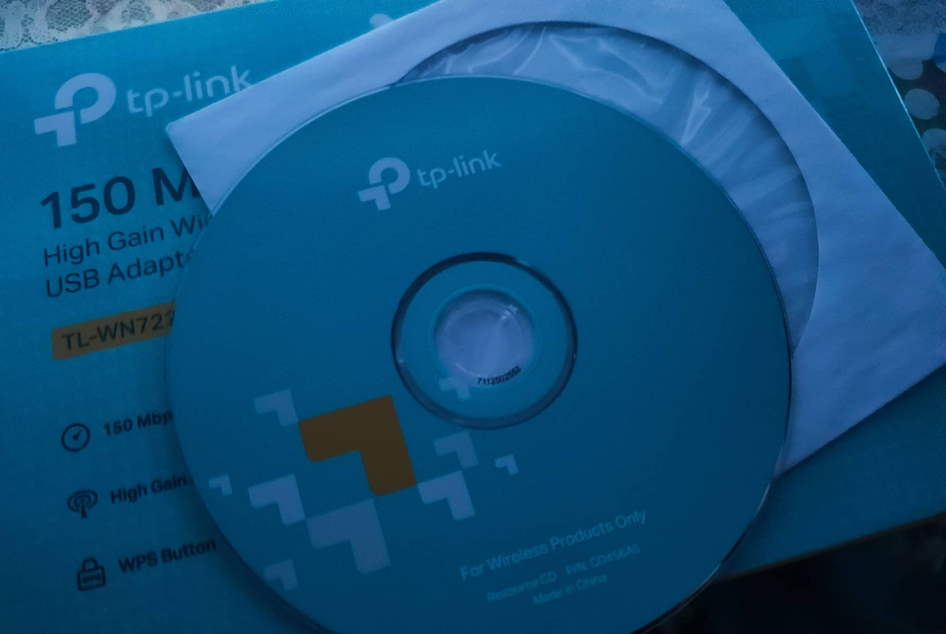
1- Install on windows
Plug ‎TL-WN722N To Computer
Plug CD To CD Room
Open CD File
Discover & Scan For TL-WN722
Wait For Install Driver

Slide 3
2- Install on Linux
Open Terminal
WRITE “sudo apt update –y && sudo apt upgrade”
sudo apt install dkms
sudo rmmod r8188eu.ko
git clone https://github.com/aircrack-ng/rtl8188eus
cd rtl8188eus
sudo –I
echo "blacklist r8188eu" > "/etc/modprobe.d/realtek.conf"
exit
sudo reboot

Slide 4
2- Install on Linux
11- cd rtl8188eus
12- sudo make
13- sudo make install
14- sudo modprobe 8188eu
##Done

Slide 5
✔ Enable Monitor mode ✔
sudo ifconfig wlan0 down
sudo airmon-ng check kill
sudo iwconfig wlan0 mode monitor
sudo ifconfig wlan0 up
ifconfig

Slide 6
END .....

Slide 7
You can Ask Me ON ?
Facebook : https://www.facebook.com/m3lomatthephone
My YouTube Chanel : https://www.youtube.com/c/m3lomatthephone
M3lomat the phone 2 : https://www.youtube.com/channel/UCixopZbFBzdYKk2qsZLsRCA
M3lomat Electric : https://www.youtube.com/channel/UCGnXhX2E_MaGYOY8kyOowbQ
Instagram : https://instagram.com/mena.m.rushdy?igshid=1xg5sxvjtek7i
LinkedIn : https://www.linkedin.com/in/mina-magdy-38362b1b6/
Facebook Group : https://www.facebook.com/groups/391033085092937

